Slide 1
CS302 Operating System Lab 2 Process, Pipe and Signals
CS302 TA group
Thanks Chuang Yang for linux environment

Slide 2
Process
Today, we will focus these five main keywords:
pid: process identifier
fork: a function that duplicate a process
exec*: a function family that replace a process
signal: handle unexpected situations
pipe: Inter-process Communication

Slide 3
Process Identification
Command of showing Process in Linux:
top, ps, (htop)…
just man them to see details if you are not familiar of them
We can identify one process uniquely by its Process ID (PID)
we can use getpid() to get the pid of current process

Slide 4
In class practice
Write a C program that use getpid() to display the pid of current process.
Try man getpid if you do not know how to use it
Don’t be shy to ask questions

Slide 5
Process Creation
Use system call fork to create a process
after fork, the original process splits into two
fork copies almost all things about the original process
OS allocates the pid, and pass the value to fork()

Slide 6
In class practice
Write a program that call fork() to generate a new process, and print the pid of the processes( both parent and child process)
Try man fork if you are not familiar with the function
Don’t be shy to ask questions

Slide 7
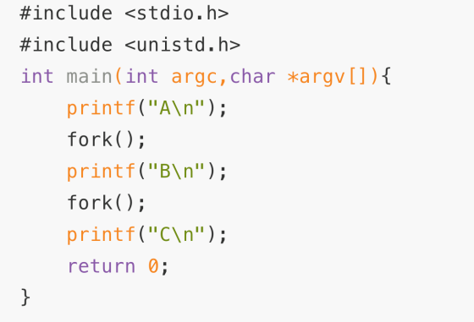
Process Creation
Exercises : How many A, B and C will be printed?
A: 1 time, B: 2 times, C: 2 times
A: 1 time, B: 2 times, C: 4 times
A: 1 time, B: 1 times, C: 2 times
A: 1 time, B: 2 times, C: 3 times

Slide 8
Process Creation
The sequence of process running after fork:
Parent1
fork()
Parent1
Child1
fork()
Parent1
Child2
Child1
Child3
Who runs first ?

Slide 9
Process Creation
Exercises : The result of running the following program is ?
(A) A\nB\nB\nC\nC\nC\nC\n
(B) A\nB\nC\nB\nC\nC\nC\n
(C) Not sure

Slide 10
In class practice
Write a program that verify the return value of fork() function.
Try man fork if you are not familiar with the function
Don’t be shy to ask questions

Slide 11
Process Execution
exec*() function family
Contains: execl, execlp, execle, execv, execvp, execve.
Only one system call: execve()
“l” means list, “v” means vector
“p” means path, “e” means environment
Try man exec to see details

Slide 12
In class practice
Write a simple program that print anything you want. And then call exec*() function to execute it.
Try man exec if you are not familiar with these functions
Don’t be shy to ask questions

Slide 13
fork() + exec*()
Now, we have the method to duplicate a process
And, we have the method to replace a process
Then we can get …

Slide 14
fork() + exec*()
We can get diversity functions we need

Slide 15
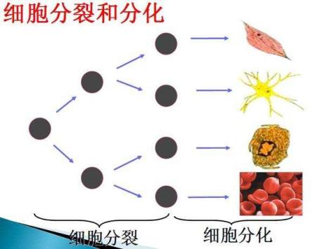
Interesting idea of mine
fork() like cell division
exec*() like cell differentiation
Init process like Fertilized egg
What we can get is actually a human.

Slide 16
fork() + exec*()
Let’s return to the topic we discussed before:
The sequence of running a program.
What does shell exactly do.
But if we want the process running in the way we want ?
wait*(), signal(), kill()
Try man wait to know details

Slide 17
fork() + exec*() + wait()
After require IO, our process can call wait*() to suspend until be waked up.
wait() for any one of the children, and only detect the termination
waitpid() depends on the parameters
process
Require IO
response
OS

Slide 18
In class practice
Write a program that after fork(), the child process runs first. And then parent runs.
Recall shell’s command

Slide 19
Signal
Signal is a kind of interrupt to the running process.
SIGINT, SIGCHLD, SIGHUP, SIGALARM
Signal handling
Ignore
SIGKILL, SIGSTOP never be ignored
Catch
By user function
Default
By kernel default handler

Slide 20
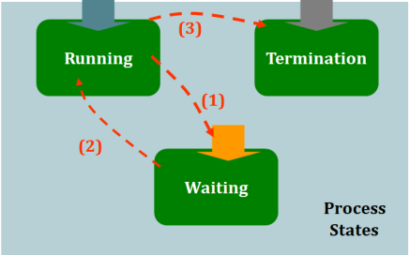
Signal
Signals
Signals play a really important role in switching process states.

Slide 21
Signal
Signal sending(kill, sigqueue)
kill() send a signal to process
Try kill -l to see all signals
Signal registration(signal, sigaction)
signal() functions is used to set the handler when the process received a given signal.
E.g. signal(SIGINT, my_handler) will let the process run function my_handler when reveived signal SIGINT.

Slide 22
In class practice
Write a program that waiting for signal SIGINT. After the first time from receiving SIGINT, the process must ignore SIGINT. And find a way to test your program.
Hint: You may need getpid(), signal() functions and kill command
If you are not familiar with these functions/commands, use man
Be free to ask questions, but I hope you can solve your problems by yourself.

Slide 23
Pipe
pipe overview
Pipe is a unidirectional data channel for inter-process communication.
System call pipe ()
pipe() will create a pipe.
Try man pipe to know details.
File descriptor: handle used to access a file or other input/output resource.

Slide 24
Learn to use pipe
A pipe
A pipe with fork
Why they share the same pipe?

Slide 25
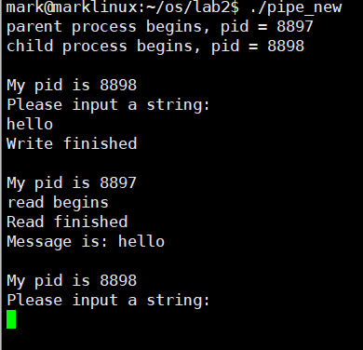
In class practice
As you know, if we want to do inter-process communication, we need at least two processes. Write a program that call fork() to generate a child process, and use pipe() to create a pipe between them. And then, you should input message in one of the process and display the message in the other process.
If you are not familiar with these functions/commands, use man
Be free to ask questions, but I hope you can solve your problems by yourself.
An exampe:

Slide 26
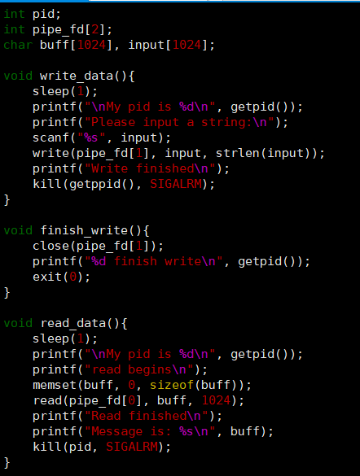
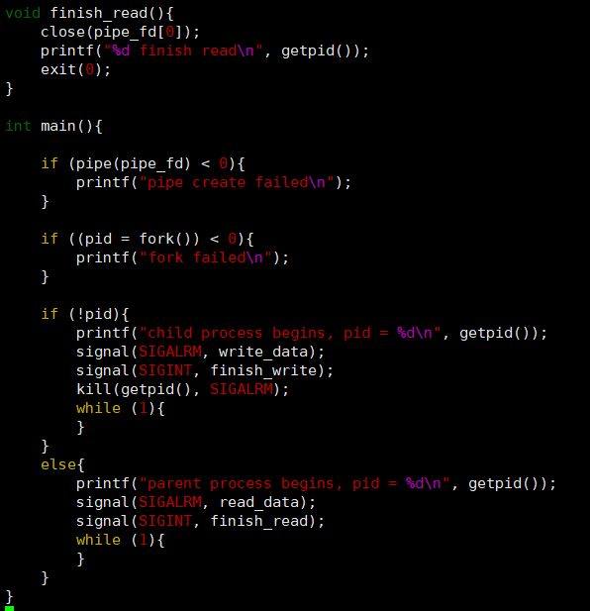
Read code together

Slide 27
Assignment
Finish the Lab report.

